Slide 1
Securing the Channel

Slide 2
Overview…
Security Breaches
Security Considerations
Types of Attacks
Social Engineering
Brute Force Attacks
Password Protection
Choosing a strong password
Login Systems
Password storage security
Encryption and Hashing
Firewalls
IP Filtering

Slide 3
Introduction
This module makes no claim in providing a definite claim in securing your web applications
This lecture will cover as much relevant material as I can with practical solutions
The plan is to take apart the DVD swap shop and identify the weaknesses and making recommendations on how to improve the security

Slide 4
Security Breaches
At some point each website will need to manage some form of user input
  Log In forms
  Registration
  Search
This should be fine in perfect world
However inevitably this attracts the wrong kind of attention.
Why?
  Passwords, Credit Card information

Slide 5
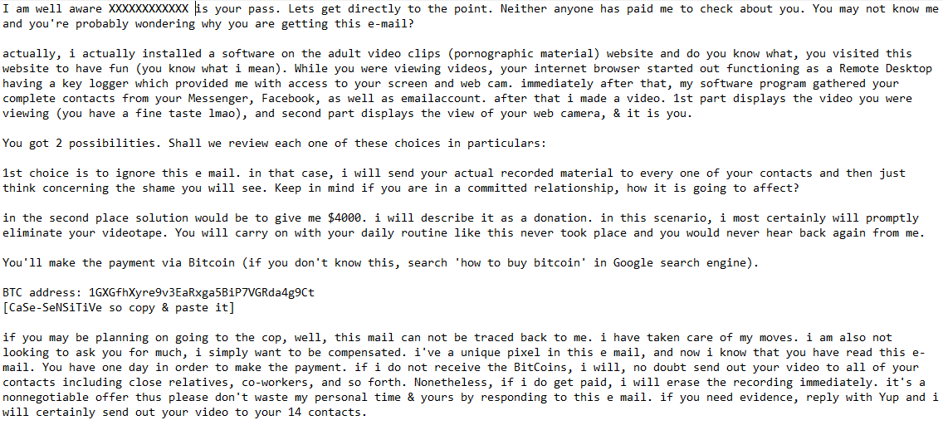
LinkedIn Email

Slide 6
Pillars of Security
In regards to security there are three pillars of security
  Confidentiality
    This is the privacy of the data that is being stored on the system. This will include personal details, credit card information
    Preventing someone from reading information that they are not authorised to read
  Integrity
    Preventing data from being modified without the proper credentials or authorisation
    Can be compromised through accidental events
  Availability
    Losing access to data or service e.g. Email, Ecommerce.

Slide 7
Security Considerations
There are also three main areas to look ay in regards to security
  Secure Communication
    Prevents third parties from accessing the data
    Includes physical security of server and data as well as the communication channel
  Authentication
    Identifying who is accessing the system
    They are who they say they are
  Authorisation
    Only allowed access to certain areas of the web application
    Permissions after authentication

Slide 8
Types of attacks
We will consider some common types of attacks:-
  Injection Attacks
  Social Engineering attacks
  Data interception (e.g. Packet Sniffing)
  Brute Force Attacks
  Dictionary Attacks
We are going to look at some issues to consider when securing the channel, some technical and some that are common sense
Problem is there is little “common sense” about

Slide 9
Be careful who you talk to?
Just by a general conversation what can you learn about a person?
  Pet names?
  Mothers maiden name
  Place of birth
  First school

Slide 10
Selecting Passwords
We tend to select passwords based on something we can remember. This is only natural
By people knowing more about us, it allows our passwords to be guessed easier
Guess the password?
T _ _ _ _ S
Developers can only protect the users so much

Slide 11
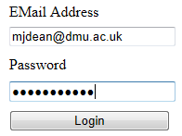
Login
The most obvious form of authentication is with the use of a login form
The user is usually identified by either an email address/ username and password
In this case…
A simple method of securing the password is by hiding each character by an asterisk
This prevents the use of shoulder surfing
Even without insider knowledge the potential of guessing passwords is still possible

Slide 12

Dictionary Attacks
This is pretty much what it sounds like
It makes use of a dictionary and attempts each password on a valid username in the hopes one of them is correct
You would be surprised how many people have a very common password
Kali contains a password file called rockyou.txt and contains 9,606,665 passwords. That’s a lot…

Slide 13
Brute force attack
Dictionary attack is a type of brute force as it tries each password in order until the correct one is found
If we know the length of the password we can create different combinations of characters until the password is found
If the password was ‘CC’ all we know it is two characters long
We would cycle through:-
  AA, AB, BA, BB, BC, CB, CC
  Until we got the correct one
  Longer the password the longer it would take to crack

Slide 14
Password Protection
So how can we increase the password security?
  Developer:
    Set Required Password length
    Set required characters for password
    Prevent too many login requests
    Password expiration
  Users:
    Educate Users on password creation
      Longer passwords
      Letters (Uppercase and Lowercase)
      Numbers
      Symbols
      Spaces (if applicable)

Slide 15
Password Prefix
A good method to adopt is the use of prefix passwords
This is where you have a set password that you use such as JL67%ghR89()
This is then modified to adopt the website you are on
E.g.
  JL67%ghR89(facebook)
  JL67%ghR89(youtube)
  JL67%ghR89(twitter)
This way your passwords are different to every site. As a lot of people use the same password

Slide 16
Choosing a strong password
Line from favourite song.
  Iw2BF()Fm&Q

Slide 17
Choosing a strong password
Line from favourite song.
  Iw2BF()Fm&Q
    I want to break free - Freddie Mercury and Queen
Line from favourite movie.
  WaFtS?C_Sp&nF

Slide 18
Choosing a strong password
Line from favourite song.
  Iw2BF()Fm&Q
    I want to break free - Freddie Mercury and Queen
Line from favourite movie.
  WaFtS?C_Sp&nF
    Want anything from the shop? Cornetto - Simon Pegg & Nick Frost
  YkNJS_W1c-G0t

Slide 19
Choosing a strong password
Line from favourite song.
  Iw2BF()Fm&Q
    I want to break free - Freddie Mercury and Queen
Line from favourite movie.
  WaFtS?C_Sp&nF
    Want anything from the shop? Cornetto - Simon Pegg & Nick Frost
  YkNJS_W1c-G0t
    You know nothing, Jon Snow_Winter is coming - Game of Thrones

Slide 20
Writing login systems
When creating login systems we can use various options…
  We can use an off the shelf security solution
  We can create our own
Examples of off the shelf security solutions are:-
  Windows Authentication
  Forms Authentication

Slide 21
Windows Authentication
This makes use of groups and users set up on the windows machine that the web application is running from
In order to add new users it must be done by an administrator of the machine
This is useful if it is local but not for a web application as you could see why
Most web application have a page that allows the user to create an account
Due to this being local, this would not be a viable method to create a user for a web application

Slide 22
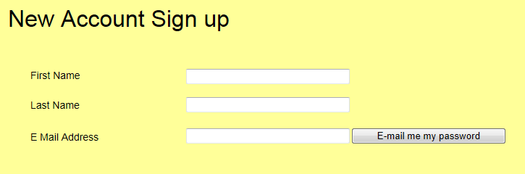
Sign up form

Slide 23
Built in Authentication
The authentication built into .NET provides a set of tools that help you create a login, sign up and change password pages
Creating your own allows you know how it works and is customisable
But if it goes wrong whose fault is it?
DIY Authentication

Slide 24
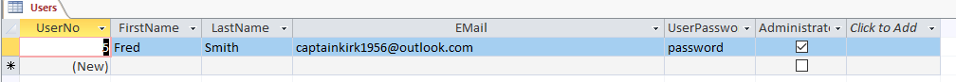
Securing Stored Passwords
Passwords need to be secured in the Data layer as well as the Presentation layer
In the DVD swap shop the user table displays the passwords in plain text

Slide 25
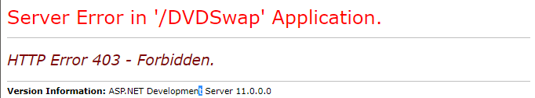
App_Data Folder
In visual studio it places the database within the App_data folder
This is a secure location that prevents the database being accessed through the browser
Using the URL of http://localhost:49597/DVDSwap/App_Data/dvd.mdb
By using this it makes the database more difficult to download

Slide 26
Encryption vs Hashing
Encryption
  Process of encoding a message using a key that can only be read by authorised users
  Allows a key to be used to decrypt the encrypted data and be seen again in plain text
  Symmetric/Asymmetric Encryption
Hashing
  A one way encryption method that is used for passwords, credit card information and anything deemed sensitive to the developers
  Prevents the data from being reversed
  But... can be compared against

Slide 27
.NET Cryptography
.NET provides a name space that handles the hashing of data
  System.Security.Cryptography
As hashing is one way it is hard to know what the original value was
  Password
  5E884898DA28047151D0E56F8DC6292773603D0D6AABBDD62A11EF721D1542D8
This is a much better method of storing passwords within a database as they can not be reversed engineered
When checking a users password, a new hash is created and it the hash matches then the user becomes authenticated

Slide 28
Salt
If a hacker gets access to the database they can apply the hash to their dictionaries and find the hashed password by discovering the hashing algorithm used
These new dictionaries are known as rainbow tables
Adding salt will make the hash much harder to decipher
Salt consists of extra data added to the data such that we are not just hashing the password
Salt is random data that is added to the string which is then hashed
The idea of salt is to defend against dictionary attacks against its hashed value

Slide 29
Salt
So what if we had two users with the same password?
  John 5E884898DA28047151D0E56F8DC6292773603D0D6AABBDD62A11EF721D1542D8
  Fred 5E884898DA28047151D0E56F8DC6292773603D0D6AABBDD62A11EF721D1542D8
Lets add salt…
  John C0C1664CC490D0FD9CE0BA81035B9199248AD16426301F03A70A4DECCDDD5990
  Fred 9Wo0irC6+92F45AC854246D5A272B8FDB620B48F32230D3FF509299AB07BC62C7396BAFB7

Slide 30

Securing the Communication Channel
So we have looked at securing the presentation layer and data layer so what about the communication itself?
As we know HTTP is passed between server and client in an unencrypted form
This allows the use of packet sniffing to intercept the communication being transmitted
Client
Server
Data channel plain text data
Client
Server

Slide 31
Encrypting Data
When encrypting data for transmission, how does the recipient get the key?
At some point I must send the key over the channel which will still allow the attacker to intercept the data being sent as the key is located within the message
Client
Server
Message + Key
Client
Server

Slide 32

Public and Private Keys
Public and Private keys are used within asymmetric encryption
A private key is personal to the user and only the user
A public key is accessed by the sender
Before sending data it’s encrypted using the recipients public key
This is then sent to the recipient
Once received, the message is decrypted
using the recipients private key
This prevents interception from being
possible as they do not possess the private
key being used for decryption
Client
Server
Private key (decode)
Message + public key (encode only!)

Slide 33
Secure Socket Layer (SSL)
SSL uses a system of public and private keys to encrypt the data
  The browser makes a secure HTTP request HTTPS on port 443
  The server sends back a digital certificate verifying its credentials
  The client verifies the certificate with the issuing agency
  Using the public key data is encrypted between client and server
Certificates are used for authentication of a trusted source. These are issued by the certificate authority
SSL setup is simple but an approved certificate by the CA is costly
These can be self signed and allow for SSL but generate the following error

Slide 34
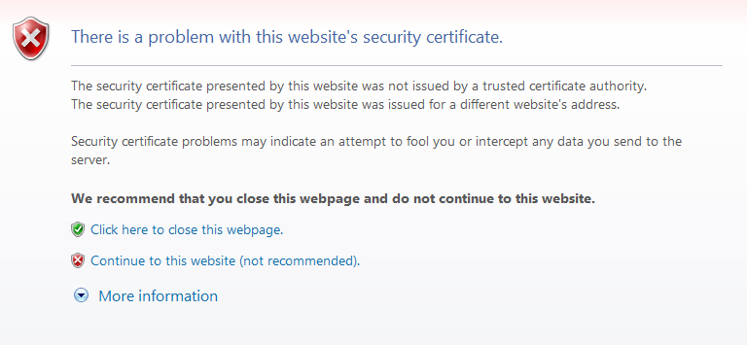

Slide 35
Validation – All input is Evil
Who do you trust?
You have all signed up on G677 which means I know a great deal about you all
What if I used that data?
Do you trust the application you are using to help with your assessment?
Entering data is one way of our applications gathering data but what about from external sources?
What if we use another site? Are there systems as secure as yours?
What if you download XML from another source and it happens to contain harmful scripts or SQL injection code?

Slide 36
Firewalls
Attacks make use of a port scanner that scans the IP address for all open ports from 1 – 65535
Open ports are then probed to see what services the port is used for and check if a connection can be made
A firewall restricts access to servers and services on a network by monitoring ports and only allowing authorised users to access these servers or services
This reduces the surface area of the machine and aids in prevention of an attack

Slide 37
IP Filtering
Alongside encrypting the data stream we should also control the machines that access the server through HTTP requests
Filters allows us to allow and deny access to the server through IP ranges
This could be to only allow access to the server through a valid DMU IP address
Access from other addresses would be completed on a case by case basis
Internet Information Services (IIS) enforces a reverse DNS lookup
A reverse DNS lookup checks the IP address of the HTTP connection and verifies if it is in fact part of the domain it claims to be in

Slide 38
Unused Services
The rule here is if you don’t use it, turn it off!
The default position with software such as Windows Server is to have pretty much all services unavailable
You turn then on as you need them
In the case of Windows Server 2008 you cannot even browse the internet without being asked security questions

Slide 39
Permissions
During development, permissions are usually set to maximum so you are not firefighting when developing
When deployed these permission should be set to minimum to prevent unauthorised access to data that users are not authenticated to view
In regards to SQL, If the user only needs to view information then only give them permissions to read
They have no need to Write and Delete

Slide 40
Recap…
Security Breaches
Security Considerations
Types of Attacks
Social Engineering
Brute Force Attacks
Password Protection
Choosing a strong password
Login Systems
Password storage security
Encryption and Hashing
Firewalls
IP Filtering

